Slide 1

Introduction
13. februar 2018

Slide 2





Professional me…
Software developer since March 2015 Part time at Champ | Finished engineering degree January 2017 Teaching assistant since 3rd semester | Working in software development since 2008
Today… | Senior Software Developer At Umbraco A/S

Slide 3
Prior experience
Software and test developer at Bang & Olufsen
External Consultant at Afrost
Web developer at nfrmtn (pronounced Information)
Software Consultant at Oxygen A/S
Senior Developer at Champ ApS
External Consultant at Saxo Bank A/S

Slide 4
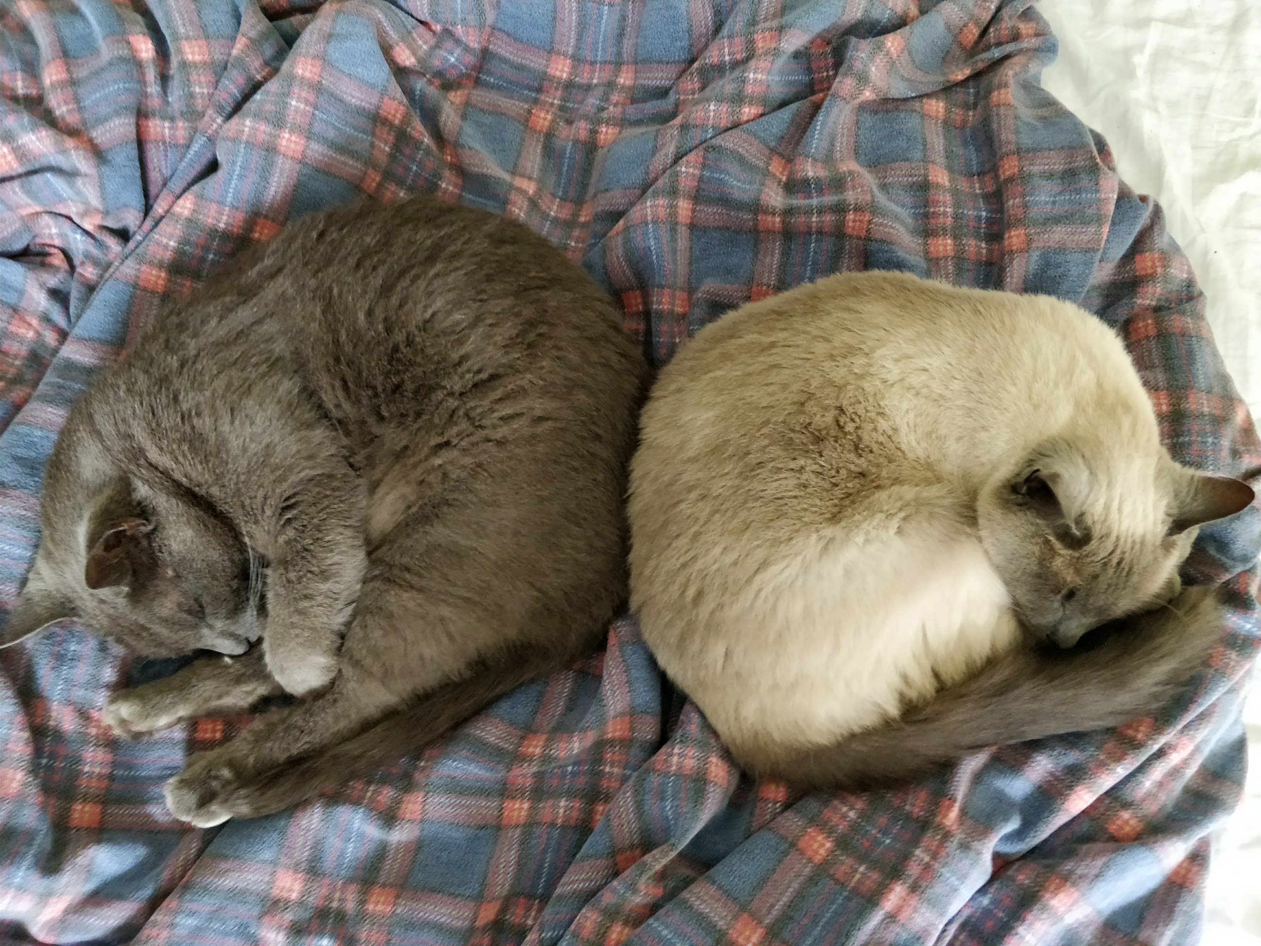
Personal me…
27 years old
Originally from Southern Jutland
I love cats, I have two :D
Got a wonderful girlfriend whom I also love!
Deeply interested in Home Automation

Slide 5
Contact
Mail me → me@nbo.codes
Please do NOT use any other email than the one stated above, I will not answer any mails related to teaching here at SDU on other mails.

Slide 6
My expectations for you
Basic understanding of programming
Both front-end and back-end
Clean and consistent code
Including documentation
Well-founded decisions
Please explain your choices
Works in all major browser
i.e. Google Chrome, Mozilla Firefox, Safari and Microsoft Edge

Slide 7
What you can expect from me
1 assignment
Hands-on approach
Exercises every lesson
Cutting-edge technology
Hopefully this won’t be outdated when you guys are done!
At least that is my hope!
Group work
2-3 people in a group

Slide 8
Goal? Create a website!
My plan is to make you all create your own personal website.
The intention is to start at the client side and work our way to the server side.
You will be able to build upon your solution during the semester.
There will be one assignment, but I will release extra requirements during the semester.

Slide 9
Requirements
The website
Login form / Sign up
Gallery
Upload form
Technical
.NET core backend
Database for storage

Slide 10
How?
Work in groups of 2-3 people
I’ll create groups on BlackBoard – if I’m able to…
Only one member has to hand in the assignment
You organize the groups yourself, you’re grown ups!
The hand-in will be a direct link to your github repository.

Slide 11
Getting ready
What you need:
.NET Core SDK 2.0
An IDE
Jetbrains RIDER EAP (Cross platform)
Visual Studio 2017 (Windows only)
Visual Studio Code (Cross platform)
Omnisharp
Visual Studio for Mac
A datastore
MSSQL Express
MySQL
PostgreSQL
MongoDB
Or any online service you know about
AWS S3, TableStore on Azure etc.

Slide 12

The history of the Internet

Slide 13
Precursor of the Internet
The Internet could not have existed without the two major inventions of the
19th Century:
Electricity
Telegraph system.
To a lesser degree, broadcast media
such as radio and television

Slide 14
What is the Internet?
Plain and simple, it is a world wide system of interconnected networks and computers

Slide 15
Well… What is a network?
A computer network is best described as an interconnection of a group of computers

Slide 16
1969 - ARPANET
Based on work from MIT, RAND, NPL
Originally had 4 mainframes.
Connected using 50 kbps lines
First time computers was consistently communicating
More Computers were added.
First message sent said “Lo” → Should have been “Login” #error
Loading…

Slide 17
1969 - ARPANET
The internet was an accident
It is based on a unsuccessful result of a military research program
Loading…

Slide 18
1972 - Email
Invented by Ray Tomlinson
Loading…

Slide 19
1973 – A protocol is needed
Heterogeneous networks.
Communications would be on a best effort basis.
Communication forwarding by stateless routers/switches
No global control.
Loading…

Slide 20
1974 – TCP/IP
Invented By Cerf and Kahn
Became standard in circa 1980
Loading…

Slide 21
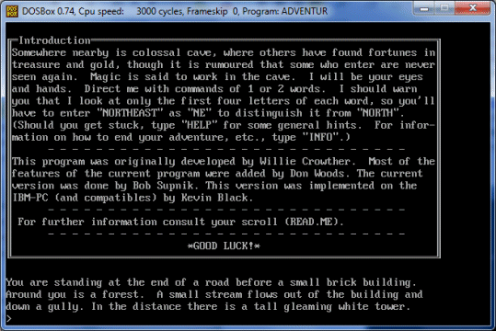
1978 – First MMORPG
MUD1 Multi-User Dungeon
Loading…

Slide 22
1983 – Domain Name System
A hierarchical decentralized naming system
A system for translating human readable server names into addresses.
.
COM
GOOGLE
FACEBOOK
DK
OXYGEN
Root
TLD
2nd lvl
Loading…

Slide 23
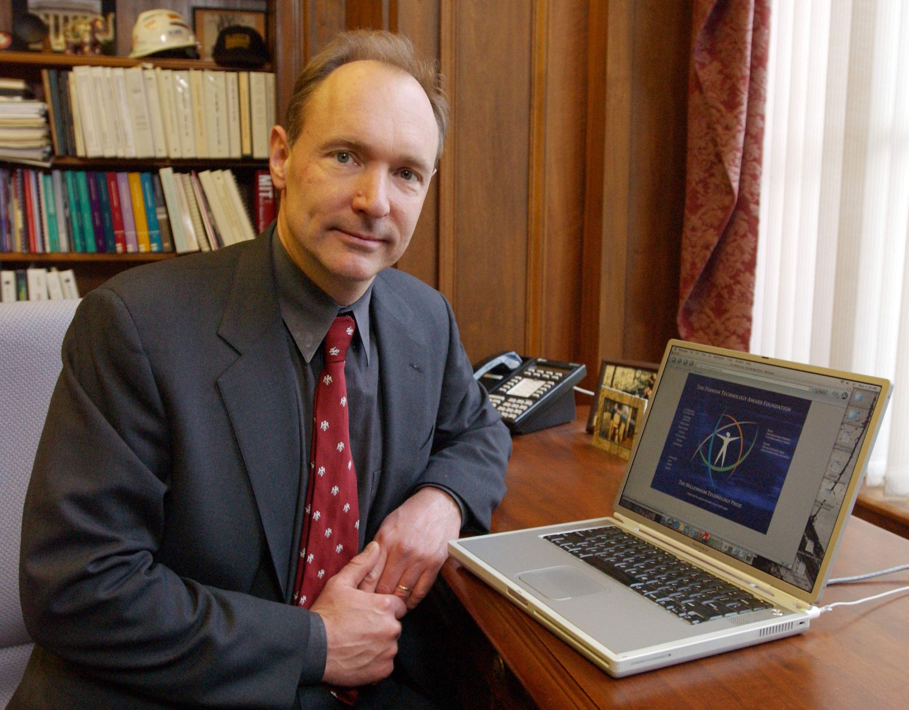
1989 – World Wide Web
Invented by Tim Berners-Lee @ CERN
HTML, HTTP, URI
First Browser
First web server
Loading…

Slide 24
1994 – Web for everyone
Personal computers became popular
Internet connections at home
E-commerce started to emerge
Loading…

Slide 25

1998 - Google
Started in september 1998
Search engines sucked at the time
Focused on analysing content instead of keywords
Loading…

Slide 26
2002 – Web 2.0
Easy to access
User created content
Dynamic websites
RSS 2.0
Loading…

Slide 27
2003 – Social media
Who have been on a social media since I started this lecture?
Twitter, Facebook, 500px, Instagram, Baidu, Wikipedia, LinkedIn, etc
Loading…

Slide 28
2007 – Going mobile
Apple introduced the iPhone
WAP was replaced by GPRS
Today we have LTE (4G) (Soooo fast, 5G up next!)
Advent of responsive web design
Loading…

Slide 29
2013 - Internet of Things
Everything is connected.
Heterogeneous devices
Loading…

Slide 30
Internet of Today
Omnipresent
Vital infrastructure in many parts of the world.
40% of the world's population are connected.
Complete!

Slide 32
1969
ARPANET was born. 4 nodes were inter-connected:
UCLA,SRI,UCSB, U. of Utah
Charley Kline from UCLA sent 1st packet.
First RFC by Steve Crocker.

Slide 33
1970
RFC maintained by Jon Postel (the RFC-editor).
ARPANET used NCP (Network Control Protocol), first end-to-end protocol

Slide 34
1971
15 nodes were connected.
Ray Tomlinson of BBN invented email program.

Slide 35
1972
@ was chosen by Ray Tomlinson to separate the userid and hostname.
First computer-to-computer chat program at UCLA.

Slide 36
1973
Ethernet was invented by Bob Metcalfe's (Harvard PhD Thesis)

Slide 37
1974
TCP (Transmission Control Protocol) was invented by Vint Cerf and Bob Kahn.

Slide 38
1975
First mailing list was created by Steve Walker.

Slide 39
1976
Queen Elizabeth II sent out an email.

Slide 40
1978
TCP splited into TCP and IP.

Slide 41
1979
3Com was co-founded by Bob Metcalfe.

Slide 42
1981
BITNET (Because It’s Time NETwork) was started.

Slide 43
1982
DoD used TCP/IP to inter-connect networks. Thus, the Internet!!!

Slide 44
1983
NCP → TCP/IP.
ARPANET was split into ARPANET and MILNET.
BSD included TCP/IP.

Slide 45
1984
DNS (Domain Name System) was introduced.
> 1000 hosts.

Slide 46
1986
NSFNET was created, connecting 5 super-computers.
IETF was formed.
NNTP was created.

Slide 47
1987
> 10,000 hosts.

Slide 48
1988
First Internet Worm released by Morris.
CERT (Computer Emergency Response Team) was formed as a result.
IRC was created.

Slide 49
1989
> 100,000 hosts

Slide 50
1990
ARPANET ceased.
AOL, CompuServe provided dial-up service.

Slide 51
1991
WWW was created by
Tim Berners-Lee from CERN.
Linux was released by Linus Torvalds.

Slide 52
1992
> 1,000,000 hosts.
MBONE was created.

Slide 53
1993
Network Solution, Inc was chosen to provide domain name registration.
www.whitehouse.gov online.
Mosaic was created.

Slide 54
1994
NSFNET was transformed to commercial network.
Shopping mall.
Can order pizza online.

Slide 55
1995
NSFNET was reverted back to research-only network.
Realaudio started.
Netscape IPO.
Win95 released.
Bob Metcalfe predicted the Internet would collapse.

Slide 56
1996
Browser war (Netscape vs. IE) began.
tv.com sold to CNET for $15,000.

Slide 57
1997
www.whitehouse.com online.
business.com sold for $150,000

Slide 58
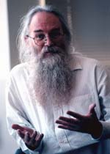
1998
2M domain names registered.
Compaq bought altavista.com for $3.3M.
Google founded.
Jon Postel (RFC-editor) died.

Slide 59

1999
First online banking.
business.com sold for $7.5B
Napster released.
Al Gore invented the Internet???

Slide 60
2000
Millennium bug.
Dotcom → dotgone.
Clinton made first webcast.

Slide 61
2001
Wikipedia launched.

Slide 62
2002
Myspace launched.

Slide 63
2003
Facebook launched.

Slide 64
2005
Vint Cerf joined Google.

Slide 65
2006
> 439M hosts.
10 new computers joined the Internet every second.

Slide 66
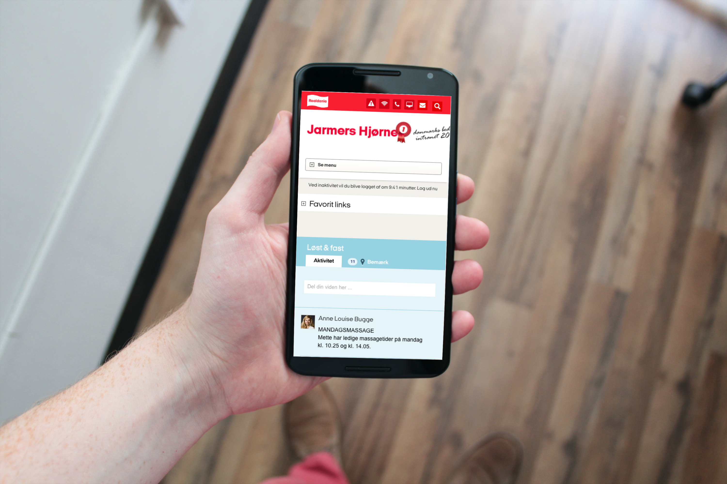
Questions?

Slide 67

Brugbare elementer
Dobbeltklik for at ændre farve eller indsætte baggrundsbillede

